Slide 1
Object Basics
A
Notes:
The Evolution of Object Oriented Programming.
It’s a warm summer evening circa 1972. Dennis Ritchie takes a break from writing the C programming language and sips a lemonaid.
Actually, the roots of OO go back to the 1960s with Simula. But we’ll jump into our tale of OO with C and C++. And from here we’ll witness the rise of the three major tenets of OO: Encapsulation, Inheritance, and Polymorphism.
We’ll take a quick peek under the covers and see how the computer works and how the mechanics of OO are implemented.
We’ll go fast in this lesson, but don’t panic. The rest of the lessons in this course dive into these OO topics at a slower pace. Knowing a little about how your program really works its magic makes you a better programmer. And hopefully, this journey will be a fun one. It’s one of my favorite topics!

Slide 2
See Also
https://www.
Notes:
Here is some additional reading on the web. That last link is my own personal web site.

Slide 3
Using Objects
CREATE
(Heap)
logger = RootLogger()
logger.setLevel(DEBUG)
logger.warning('Bad things!')
logger.debug('Starting up')
b = logger.isEnabledFor(WARN)
Python
USE
CREATE
(Heap)
CSVReader csv = new CSVReader("mydata.csv");
String [] row = csv.getNextRow();
csv.close();
Java
USE
Garbage Collected
Garbage Collected
CREATE
(Heap)
RESTClient * client = new RESTClient("https://io.ada.com");
string resp = client->get("/freezer_data");
client->post("/freezer_data", "-10.5");
delete client;
C++
USE
CREATE
(Stack or nested)
RESTClient client("https://io.ada.com");
string resp = client.get("/freezer_data");
client.post("/freezer_data", "-10.5");
C++
USE
Manual Delete
Automatic Delete

Slide 4
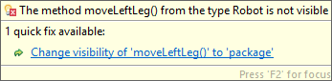
Defining Classes
class Robot {
private void moveLeftLeg() {
}
private void moveRightLeg() {
}
public void sayHi() {
System.out.println("Beep Beep");
}
public double getBatteryLevel() {
return 0.0;
}
public void goTo(double lat, double lng) {
moveLeftLeg();
moveRightLeg();
}
}
Java
Robot rob = new Robot();
rob.sayHi();
double charge = rob.getBatteryLevel();
rob.goTo(34.738, -86.60);
rob.moveLeftLeg();
Java
Notes:
Order of public/private?
Show “this.method” in future slide … when “this” makes sense with data
Public API
Naming conventions
Creating objects
Methods and self/this
Access (public, private) Enforced at runtime. Doesn’t mean much to python.

Slide 5
Defining Classes
class Robot {
private:
void moveLeftLeg() {
}
void moveRightLeg() {
}
public:
void sayHi() {
cout << "Beep Beep" << endl;
}
double getBatteryLevel() {
return 0.0;
}
void goTo(double lat, double lng) {
moveLeftLeg();
moveRightLeg();
}
};
C++
Robot * rob = new Robot();
rob->sayHi();
double charge = rob->getBatteryLevel();
rob->moveLeftLeg();
C++
error: 'void Robot::moveLeftLeg()' is private
void moveLeftLeg() {
^
error: within this context
rob->moveLeftLeg();
Notes:
Order of public/private?
Show “this.method” in future slide … when “this” makes sense with data
Public API
Naming conventions
Creating objects
Methods and self/this
Access (public, private) Enforced at runtime. Doesn’t mean much to python.

Slide 6

Defining Classes
class Robot:
def _move_left_leg(self):
pass
def _move_right_leg(self):
pass
def say_hi(self):
print('Beep Beep')
def get_battery_level(self):
return 0.0
def go_to(self,lat,lng):
self._move_left_leg()
self._move_right_leg()
def go_to(self,lat: float,lng: float) -> None:
self._move_left_leg()
self._move_right_leg()
Python
rob = Robot()
rob.say_hi()
lev = rob.get_battery_level()
rob.go_to(34.738, -86.60)
rob._move_left_leg()
Python
Notes:
Order of public/private?
Show “this.method” in future slide … when “this” makes sense with data
Public API
Naming conventions
Creating objects
Methods and self/this
Access (public, private) Enforced at runtime. Doesn’t mean much to python.

Slide 7



Islands of Data
Robot bob = new Robot();
bob.goTo(20);
int x = bob.getLocation();
Robot jan = new Robot();
jan.goTo(30);
int y = jan.getLocation();
Robot pat = new Robot();
pat.goTo(50);
int z = pat.getLocation();
Java
Location: 20
Battery: 95%
Location: 30
Battery: 63%
Location: 50
Battery: 5%

Slide 8

Data Members
class Robot {
private int location;
private double battery;
public int getLocation() {
return location;
}
public void goTo(int loc) {
location = loc;
battery = battery - 0.10;
}
public void goTo(/*Robot this*/, int location) {
location = loc;
this.location = location;
battery = battery - 0.10;
}
}
Java
Robot bob = new Robot();
bob.goTo(20);
int x = bob.getLocation();
Robot jan = new Robot();
jan.goTo(50);
int y = bob.getLocation();
Java
location: 20
battery: 95%
location: 30
battery: 63%
public void goTo(Robot this, int loc) {
this.location = loc;
}
public int getLocation(Robot this) {
return location;
}
Java

Slide 9

Data Members
class Robot:
def goTo(self,location):
self.location = location
battery = battery - 0.10;
def get_location(self):
return self._location
Python
bob = Robot()
bob.go_to(20)
x = bob.get_location()
jan = Robot()
jan.go_to(50)
y = jan.get_location()
bob.color = 'Blue'
bob._location = 100
Python
location: 20
location: 30
color: 'Blue'

Slide 10
What Time is It?
A need for Encapsulation

Slide 11
Cost Analysis
Java “Point” class has public members … for speed in the GUI library
C++ has “struct” … better word for these kinds of things?
Profile to find out
Need some insight into how it will be used in the future (crystal ball)

Slide 12

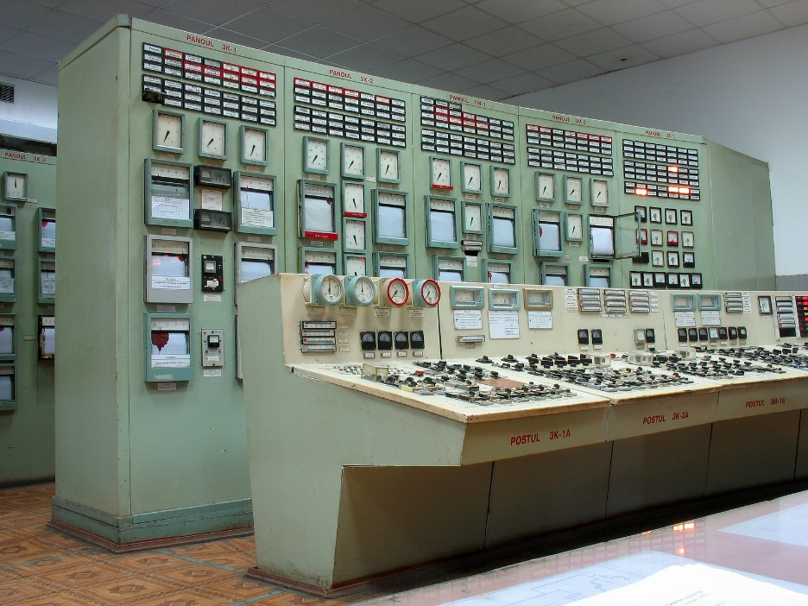

Public API
The “Interface” What “inside” these objects? We don’t know. We don’t care. They went to a lot of trouble to make this public interface for you. No need to open it up and dig around inside.
Notes:
cater to the user, don’t make the user dock to your clunky interface
Don’t just use objects that are attributes in these examples. Use objects that do things.
Terminology: fields, instances, class, members, methods
Things we usually see: User(name,address,phone), Book(isbn,author,publisher). But what do we DO to these. Not much. Just data holders. A “true” object has behavior that we use.
Python: json, requests, files, sockets
Java: CSVReader, Collator
C++: <random>
Python List, Java ArrayList, C++ vector
- list (constructor, __len__, __reversed__, __setitem__, __sizeof__, __str__, append,__getitem__,insert,clear,copy,index,pop,remove,reverse,sort,__delitem__,__sizeof__)

Slide 13

Terminology
Notes:
Verbs … user friendly …

Slide 14
Naming Conventions
Nouns, verbs
Camel case, snake case

Slide 15

Comparing Mechanics
C++
Java
Python
Defining/Creating/Using Objects
class Point {
int x,y;
};
Point * a = new Point();
a->x = 4;
Point b;
b.x = 4;
class Point {
public int x,y;
}
Point a = new Point();
a.x = 4;
class Point:
pass
a = Point()
a.x = 4
Inheritance
class NaPoint : public Point {
};
class NaPoint extends Point {
}
class NaPoint(Point):
pass
Virtual Methods
Must use the “virtual” keyword to create a vtable
Always uses a vtable
Always
Virtual Data
Never
Never
Always (all members are kept in a map)
Notes:
Copy this slide to inheritance. Only show first line here

Slide 16
Tinkering
Create
Notes:
Here are a couple of things to think about and/or try. This is totally optional … nothing for you to send to me.

